Slide 1
MATH 1010K Notes – Section 7.5
Exponents and Scientific Notation
Simplify expressions with exponents, to include:
Converting negative-integer exponents
Using properties of exponents
Product Property
Quotient Property
Product to a Power Property
Quotient to a Power Property
Power to a Power Property
Using scientific notation

Slide 2
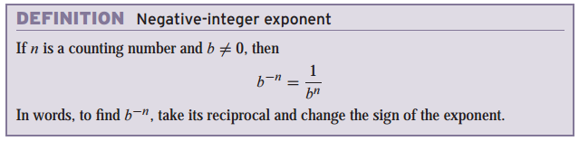
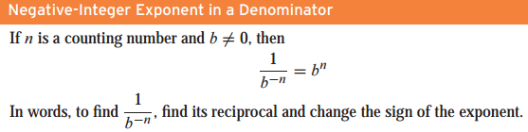
Negative Integer Exponents
Negative Exponents
Think of dealing with negative exponents as “take the stairs”

Slide 3

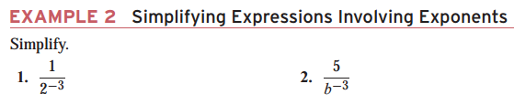
Negative Exponents
Negative Exponents

Slide 4
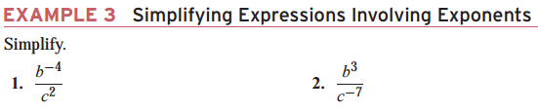

Simplifying Expressions Involving Exponents
Simplifying Expressions Involving Exponents

Slide 5
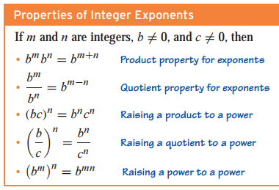
Properties of Exponents -- ** NOTECARD !! **

Slide 6
Simplifying Expressions Involving Exponents
Simplifying Expressions Involving Exponents
Property
An expression involving exponents is simplified if
It includes no parentheses.
Each variable or constant appears as a base as few times as possible. For example, we write x²x⁴ = x⁶
Each numerical expression (such as 7²) has been calculated, and each numerical fraction has been simplified.
Each exponent is positive.

Slide 7

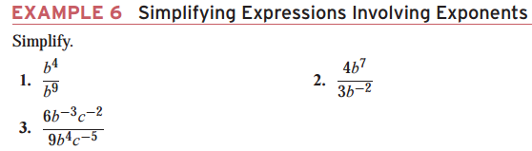
Simplifying Expressions Involving Exponents
Simplifying Expressions Involving Exponents

Slide 8
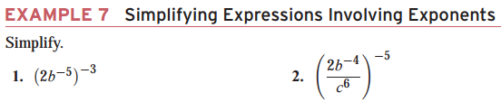
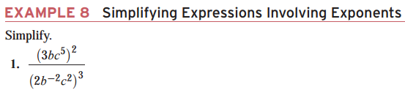

Simplifying Expressions Involving Exponents
Simplifying Expressions Involving Exponents

Slide 9
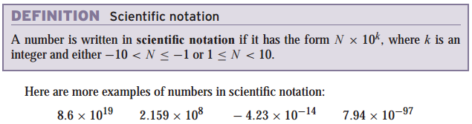
Definition: Scientific Notation
Scientific Notation
Introduction
Use exponents to describe in scientific notation
Enables compact number to represent very large or very small numbers
Use the symbol to stand for multiplication

Slide 10
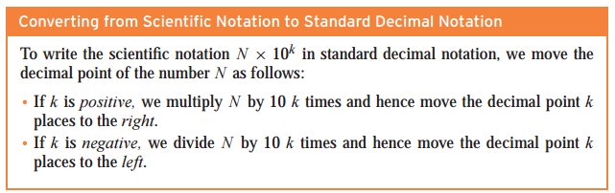
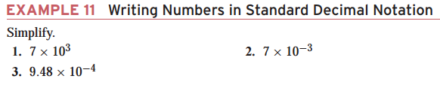
Converting to Standard Decimal Notation
Scientific Notation

Slide 11
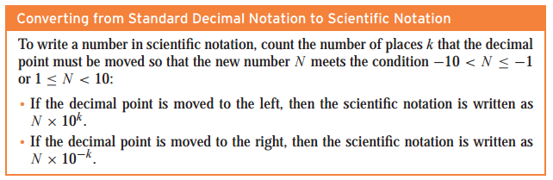
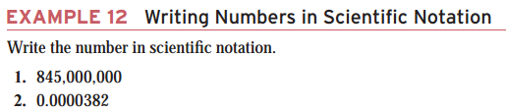
Converting to Scientific Notation
Scientific Notation

Slide 12
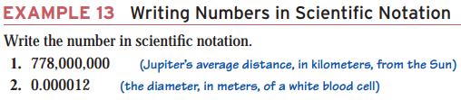
Converting to Scientific Notation
Scientific Notation

